Slide 1
Lecture 3 3D Modeling and Animation Assoc.Prof.Dr. Hossam Mahmoud Moftah Associate professor – Faculty of computers and artificial intelligence– Beni-Suef University

Slide 2
Chapter 2 Getting to Know the Production Pipeline
Working in postproduction
Using production tools
Chapter 4 Exploring Animation, Story, and Pre-visualization
Adapted from Andy Beane: 3D animation essentials 2012 by John Wiley & Sons, Inc.,

Slide 3
Working in Postproduction
Postproduction is the completion and output stage of a 3D animation project.
The postproduction stage includes the following components:
Compositing
2D visual effects (VFX)/motion graphics
Color correction
Final output
Adapted from Andy Beane: 3D animation essentials 2012 by John Wiley & Sons, Inc.,

Slide 4
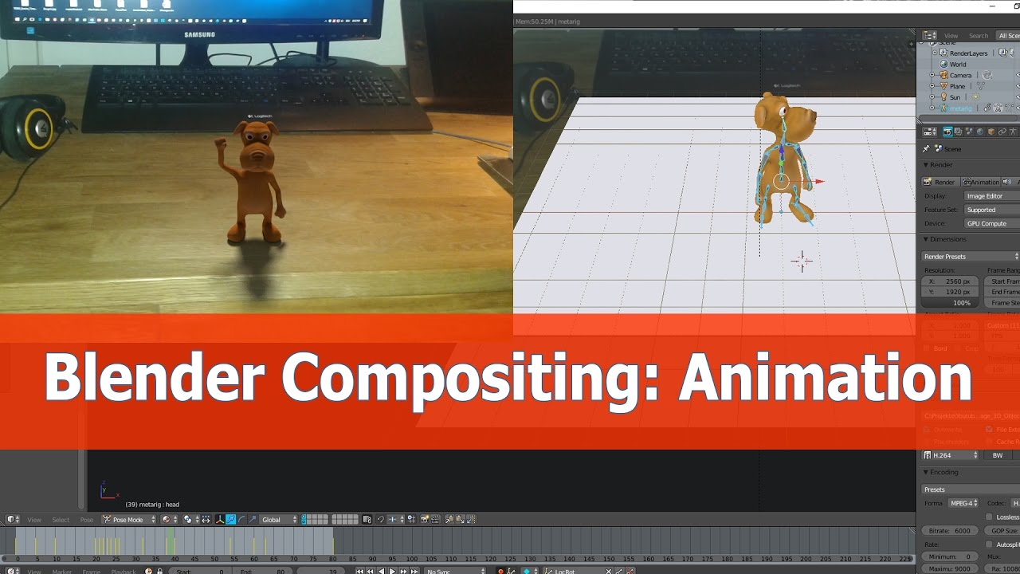
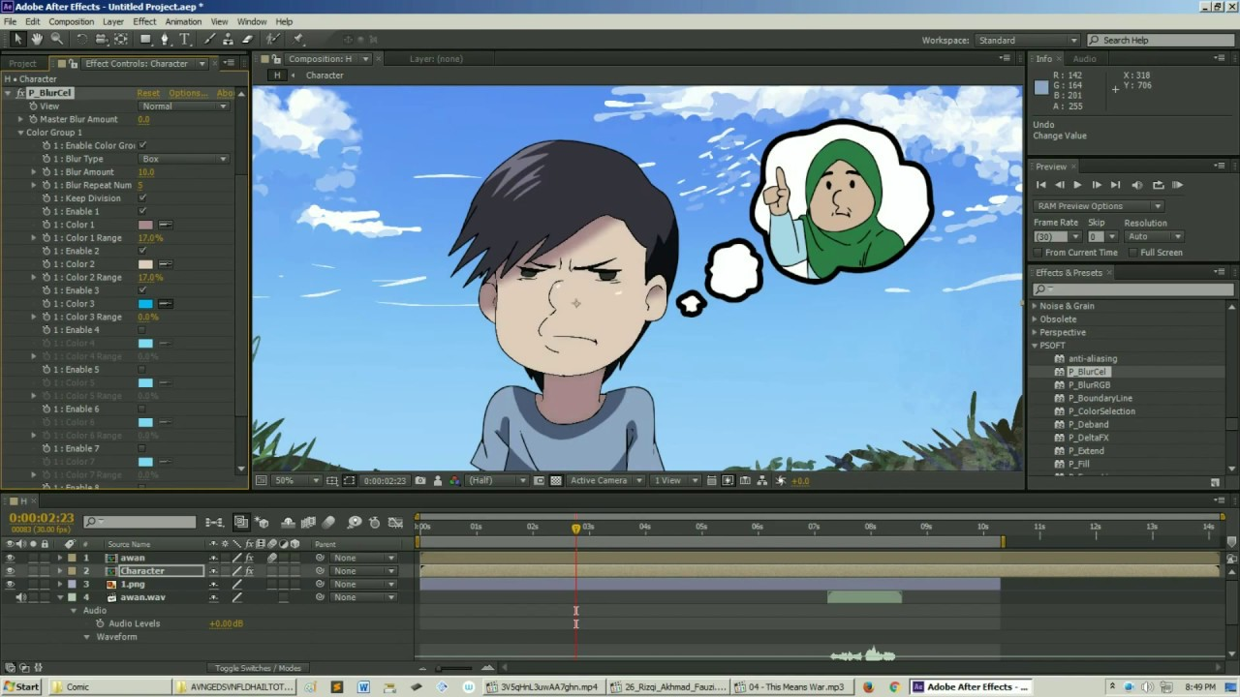
Compositing
In compositing, the postproduction artist can layer all of the imagery created and filmed to make a final output image.
The imagery can be all 3D generated images; 3D and 2D graphics mixed; or 3D, 2D, and live-action film plates.
https://www.youtube.com/watch?v=A0lvJXc19Kk&app=desktop
https://www.youtube.com/watch?v=BU-Nfy3bo6g
Adapted from Andy Beane: 3D animation essentials 2012 by John Wiley & Sons, Inc.,

Slide 5
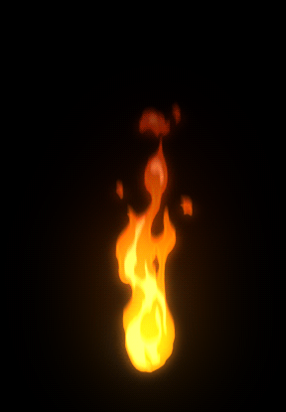
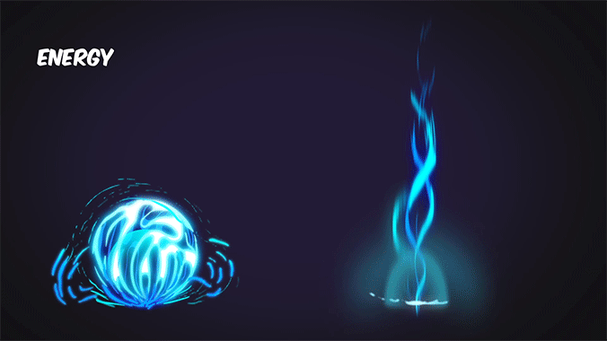
2D Visual Effects/Motion Graphics
The 2D visual effects artist will add effects that are much simpler to achieve at the end of a project in a 2D application than in a 3D application.
The compositor and 2D visual effects artists can be the same artist, but at some studios they are not.
The lighting artist may complete the initial composite for a shot and then pass the pre-comp on to the 2D visual effects artist to work on and finalize.
https://gifer.com/en/13tf
https://www.pinterest.com/pin/558376053797891480/
Adapted from Andy Beane: 3D animation essentials 2012 by John Wiley & Sons, Inc.,

Slide 6

2D Visual Effects/Motion Graphics
The following are examples of such effects:
Sparks
Pixie dust
Dust
Rain drops
Background replacements
Camera shake
Green-screen removal
Rotoscoping (use to trace over motion picture footage, frame by frame, to produce realistic action.)
Rotoscoping
Adapted from Andy Beane: 3D animation essentials 2012 by John Wiley & Sons, Inc.,

Slide 7
Color Correction
Color correction, also known as color timing or color grading, is when the entire project is adjusted to make sure all imagery color is consistent and matches the final output source.
A shot is created every time the camera changes, and there are thousands of shots in a feature film. Each shot needs to be corrected to achieve the look of the film.
It takes an expert eye and lots of practice to become good at color correction.
More on this topic in Chapter 3, “Digital Imaging and Video.”
Adapted from Andy Beane: 3D animation essentials 2012 by John Wiley & Sons, Inc.,

Slide 8
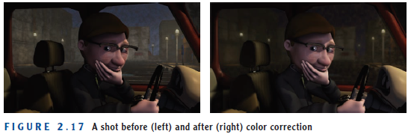
Color Correction
Adapted from Andy Beane: 3D animation essentials 2012 by John Wiley & Sons, Inc.,

Slide 9
Final Output
The final output of 3D animation can come in many different forms: film, video, Internet, rapid prototyping, 3D stereoscopic film and print media.
But the most common output type is digital video that can be played on the computer or Internet.
Adapted from Andy Beane: 3D animation essentials 2012 by John Wiley & Sons, Inc.,

Slide 10
Using Production Tools
There are some basic tools you can use to make sure everyone involved in a 3D animation project efficiently informed and up-to-date:
Production forms and documents
Folder Management and Naming Conventions
Adapted from Andy Beane: 3D animation essentials 2012 by John Wiley & Sons, Inc.,

Slide 11
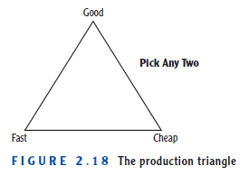
Production forms and documents
A producer also uses the production triangle (Figure 2.18) to help decide the goals of a project.
This production triangle illustrates the basic types of choices a producer must make when organizing a project and creating a timeline.
Adapted from Andy Beane: 3D animation essentials 2012 by John Wiley & Sons, Inc.,

Slide 12
Production forms and documents
Production forms and documents of an entire 3D animation project are important to allow management and artists to know what has been completed in the pipeline and what is still a work in progress.—
A production timeline is an estimated schedule of all of the stages of production.
such as production timelines and asset-tracking sheets.
great way of putting all of these documents in a central digital place without having your own team of computer scientists involved is Google Docs.
Adapted from Andy Beane: 3D animation essentials 2012 by John Wiley & Sons, Inc.,

Slide 13
Production forms and documents
In the production triangle, you can choose only two of the three corners.
Your project can be fast and cheap, but the overall quality of the project will be lacking.
Your project can be cheap and good, but it will take much longer to complete than normal.
Or your project can be good and fast, but it will cost you a lot more than normal projects.
Adapted from Andy Beane: 3D animation essentials 2012 by John Wiley & Sons, Inc.,

Slide 14
Production forms and documents
types of production timelines:
Gantt Charts
PERT ​
Calendars
Production Boards
Shot Sheet
Model-Tracking Sheet
Animation-Tracking Sheet
Lighting/Rendering–Tracking Sheet
Adapted from Andy Beane: 3D animation essentials 2012 by John Wiley & Sons, Inc.,

Slide 15
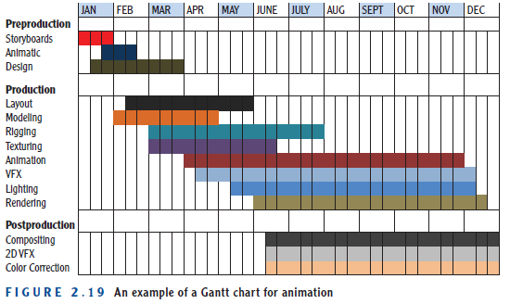
Gantt Charts
Gantt Charts These bar charts display start and finish dates for different stages of a production and indicate how long they should take to complete (see Figure 2.19).
Adapted from Andy Beane: 3D animation essentials 2012 by John Wiley & Sons, Inc.,

Slide 16
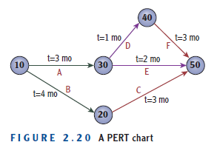
PERT ​
PERT ​ ​The Program Evaluation and Review Technique (PERT) was designed by the U.S. Navy to analyze and represent tasks required to complete a project.
numbered nodes (either circles or rectangles) representing events, or milestones in the project
linked by labeled vectors (directional lines) representing tasks in the project.
The direction of the arrows on the lines indicates the sequence of tasks.
Adapted from Andy Beane: 3D animation essentials 2012 by John Wiley & Sons, Inc.,

Slide 17
Calendars ​
Sometimes just a basic calendar is used, with colorized individual start and finish dates of the production components, and an outline to highlight the production milestones needed to complete the project.
Adapted from Andy Beane: 3D animation essentials 2012 by John Wiley & Sons, Inc.,

Slide 18
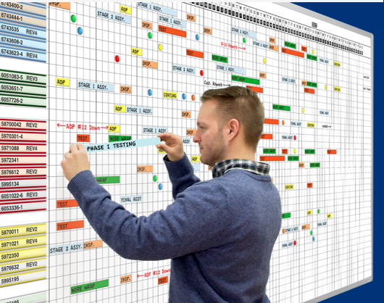
Production Boards
A production board is simply a board or a wall on which pieces of colored paper are placed.
Project milestones are written on the papers and placed in the order they will be completed
In addition, production software can be purchased to create these types of charts automatically, to help you create a timeline.
Examples include Jungle Software’s Gorilla, Entertainment Partners’ Movie Magic Scheduling (formerly EP Scheduling), and Progeny Software’s Timeline Maker.
The prices of these software options range from $100 to $400.
https://www.magnatag.com/production-boards
Adapted from Andy Beane: 3D animation essentials 2012 by John Wiley & Sons, Inc.,

Slide 19
Shot Sheet
The director and producers use shot sheets to keep track of each shot in a project.
With projects such as film that have thousands of shots, it can become difficult to know what every shot is at any moment.
A shot sheet has the name of the project at the top, the shot name, the frame count or time code for the shot, a description of the shot, and if possible, an image from the shot from the animatic or layout for quick shot recognition.
Adapted from Andy Beane: 3D animation essentials 2012 by John Wiley & Sons, Inc.,

Slide 20
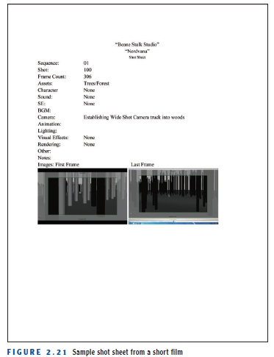
Shot Sheet
Adapted from Andy Beane: 3D animation essentials 2012 by John Wiley & Sons, Inc.,

Slide 21
Model-Tracking Sheet
Within the model-tracking sheet is the name of every model in the production,
These sheets usually include the assignments of texturing and rigging artists as well. Table 2.1 is a template for a model-tracking sheet.
Adapted from Andy Beane: 3D animation essentials 2012 by John Wiley & Sons, Inc.,

Slide 22
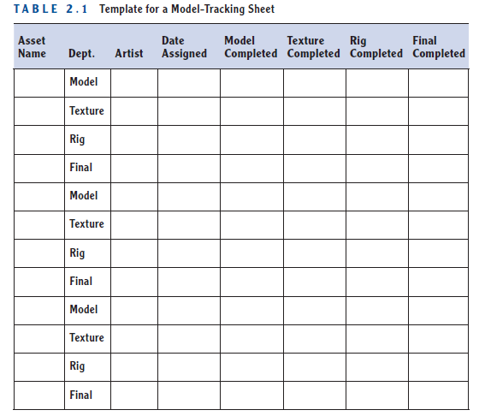
Model-Tracking Sheet
Adapted from Andy Beane: 3D animation essentials 2012 by John Wiley & Sons, Inc.,

Slide 23
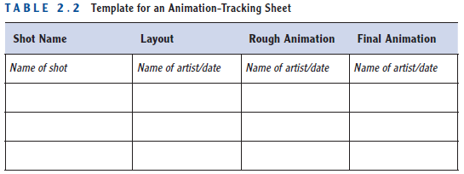
Animation-Tracking Sheet
Much as model-tracking sheets track individual assets, animation-tracking sheets track the individual animation and layout shots.
The animation-tracking sheet lists each shot, the animator assigned to the shot, and due dates for that shot. Table 2.2 shows a template.
Adapted from Andy Beane: 3D animation essentials 2012 by John Wiley & Sons, Inc.,

Slide 24
Lighting/Rendering–Tracking Sheet
Lighting- and rendering-tracking sheets track the progress of the final phases of the production stage.
the shots are listed with artists assigned to them, due dates, and completion dates. Figure 2.22 shows part of a lighting and rendering-tracking sheet in use.
Adapted from Andy Beane: 3D animation essentials 2012 by John Wiley & Sons, Inc.,

Slide 25
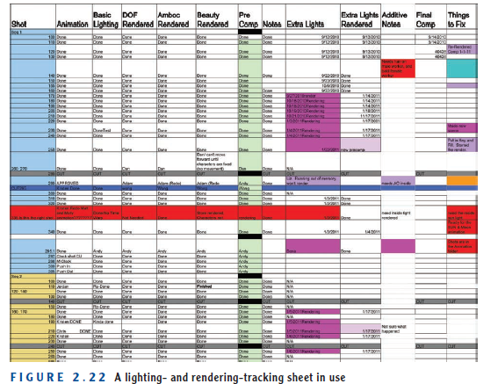
Lighting/Rendering–Tracking Sheet
Adapted from Andy Beane: 3D animation essentials 2012 by John Wiley & Sons, Inc.,

Slide 26
Folder Management and Naming Conventions
With so many people working on a project, there must be a unified naming convention for file and folder management.
A production cannot afford the lost time searching for a misnamed or misplaced file.
Typically, short and descriptive names are best, but the names can be anything.
Adapted from Andy Beane: 3D animation essentials 2012 by John Wiley & Sons, Inc.,

Slide 27
Chapter 4 Exploring Animation, Story, and Pre-visualization
The traditional visual arts
Building a good story
Using pre-visualization techniques
Adapted from Andy Beane: 3D animation essentials 2012 by John Wiley & Sons, Inc.,

Slide 28
The traditional visual arts
Considering The visual arts in the followings:
Modeling
Texturing/lighting
Character animation
Visual effects
Adapted from Andy Beane: 3D animation essentials 2012 by John Wiley & Sons, Inc.,

Slide 29
Visual arts in Modeling
Learning to really see
As a visual artist you must see the detail in your surroundings and pay close attention to minutiae.
Using Reference Images
The Internet is a great place to find images that you can use for references.
Understanding anatomy
Having true knowledge of the underlying structure of the human body helps artists understand what needs to be shown in a model.
Working with the Uncanny Valley
The uncanny valley theory is credited to the field of robotics. It states that as a robot begins to look and act more like a human, it becomes unappealing if it is not perfect.
Adapted from Andy Beane: 3D animation essentials 2012 by John Wiley & Sons, Inc.,

Slide 30
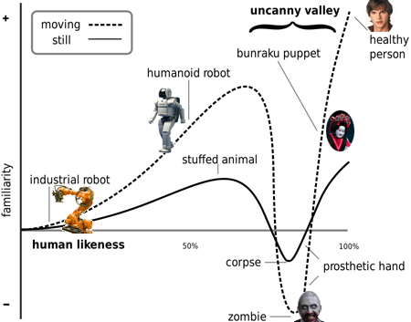
Visual arts in Modeling
Adapted from Andy Beane: 3D animation essentials 2012 by John Wiley & Sons, Inc.,

Slide 31
Visual arts in Texturing/Lighting
Texturing and lighting must tell an object’s story without saying a word.
The answers to the following questions will tell you how to texture the object:
What are you?
Where do you live?
How old are you?
Who or what lives with you?
What are you made of?
What is the most important feature about you?
Adapted from Andy Beane: 3D animation essentials 2012 by John Wiley & Sons, Inc.,

Slide 32
Visual arts in Texturing/Lighting
Using Basic Light Setups
It consists of three lights:
Key light
The key light is placed to one side of the camera and above the subject.
Fill light
The fill light is set up opposite the key light and is at the same level or slightly lower than the subject
Rim/kicker light(s)
The rim/kicker light is behind and above the subject to add a rim to the outline of the subject,
Adapted from Andy Beane: 3D animation essentials 2012 by John Wiley & Sons, Inc.,

Slide 33
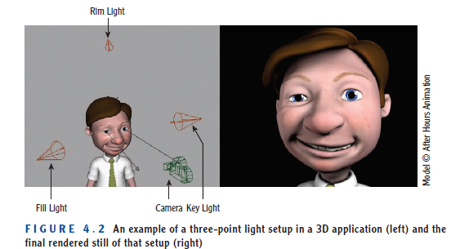
Visual arts in Texturing/Lighting
Adapted from Andy Beane: 3D animation essentials 2012 by John Wiley & Sons, Inc.,

Slide 34
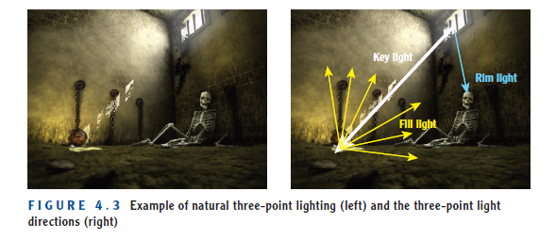
Visual arts in Texturing/Lighting
Adapted from Andy Beane: 3D animation essentials 2012 by John Wiley & Sons, Inc.,

Slide 35
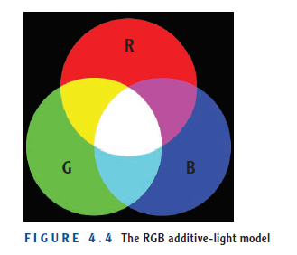
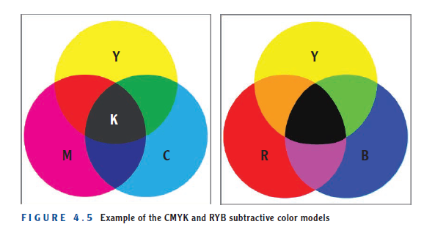
Visual arts in Texturing/Lighting
Employing Color Theory
There are two main approaches to mixing colors: an additive color model and a subtractive color model.
Adapted from Andy Beane: 3D animation essentials 2012 by John Wiley & Sons, Inc.,

Slide 36
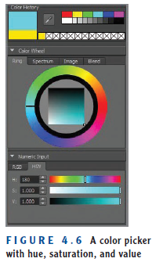
Visual arts in Texturing/Lighting
Employing Color Theory
Hue and saturation
Hue indicates the primary color selection,
Saturation is determined by the amount of light to color
and value is how much of the hue’s color selection is displayed in an additive light model
Adapted from Andy Beane: 3D animation essentials 2012 by John Wiley & Sons, Inc.,

Slide 37
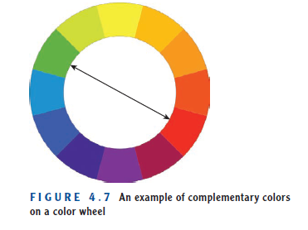
Visual arts in Texturing/Lighting
Employing Color Theory
the complementary color scheme
which on a color wheel uses the colors opposite each other—for example, red and green, yellow and purple, and blue and orange.
This type of color scheme is often used to design graphics and logos that stand out because they have a lot of visual energy.
Adapted from Andy Beane: 3D animation essentials 2012 by John Wiley & Sons, Inc.,

Slide 38
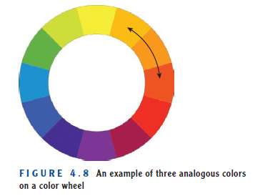
Visual arts in Texturing/Lighting
Employing Color Theory
The analogous color scheme
This scheme typically uses two to three colors that are beside each other on the color wheel, such as green and yellow-green or red-orange, orange, and yellow-orange.
The analogous color scheme (Figure 4.8), often seen in nature, is usually a color scheme that is easy to look at.
Adapted from Andy Beane: 3D animation essentials 2012 by John Wiley & Sons, Inc.,

Slide 39
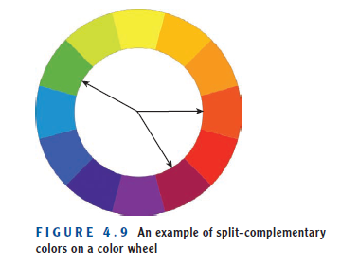
Visual arts in Texturing/Lighting
Employing Color Theory
A split-complementary color scheme
is composed of a main color and the two colors beside its complementary color. One example is green, red orange, and red-violet.
This color scheme is usually good for websites and presentations.
Adapted from Andy Beane: 3D animation essentials 2012 by John Wiley & Sons, Inc.,

Slide 40
Visual arts in Texturing/Lighting
Using Layers
The 3D images you see on the Internet, television, and film are not created in an animation program and rendered in one glorious shot.
Creating that great imagery requires many layers built on top of one another.
it is common practice to use numerous layers in Adobe Photoshop
Adapted from Andy Beane: 3D animation essentials 2012 by John Wiley & Sons, Inc.,

Slide 41
Visual arts in Character Animation
The Twelve Basic Principles of Animation are as follows:
Squash and stretch
Anticipation
Staging
Straight-ahead action and pose-to-pose
Follow-through and overlapping action
Slow-in and slow-out
Arcs
Secondary action
Timing
Exaggeration
Solid drawing
Appeal
Adapted from Andy Beane: 3D animation essentials 2012 by John Wiley & Sons, Inc.,

Slide 42
Visual arts in Character Animation
Squash and stretch
An object in motion will squash and stretch to display weight and flexibility.
The objects will get longer or flatter to emphasize:
Speed
Momentum
Weight
Mass
Adapted from Andy Beane: 3D animation essentials 2012 by John Wiley & Sons, Inc.,

Slide 43
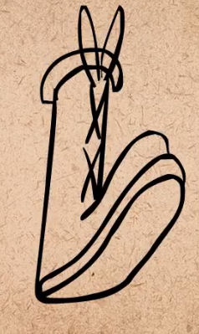
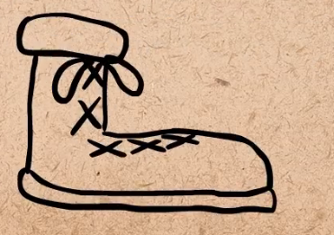
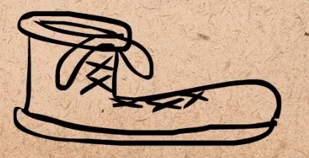
Visual arts in Character Animation
Squash and stretch
longer
flatter
Adapted from AlanBecker Tutorials- The 12 principles of animation by Frank Thomas & Ollie Johnston
Adapted from Andy Beane: 3D animation essentials 2012 by John Wiley & Sons, Inc.,

Slide 44
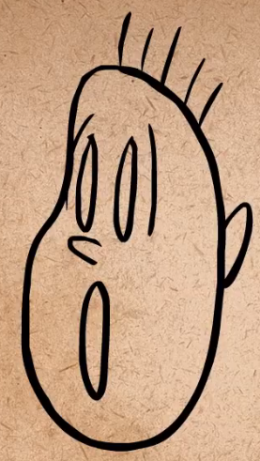
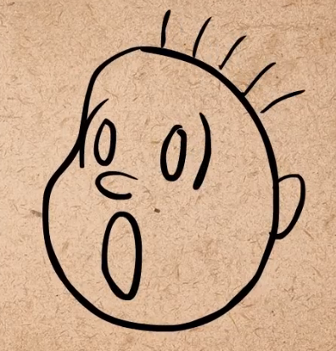
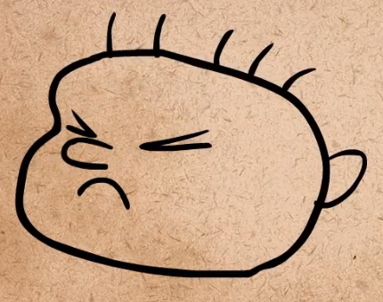
Visual arts in Character Animation
Squash and stretch
Squash
stretch
Adapted from AlanBecker Tutorials- The 12 principles of animation by Frank Thomas & Ollie Johnston
Adapted from Andy Beane: 3D animation essentials 2012 by John Wiley & Sons, Inc.,

Slide 45
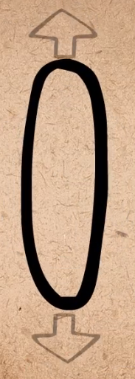
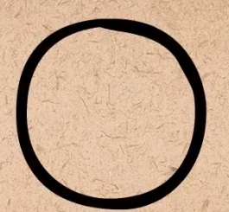
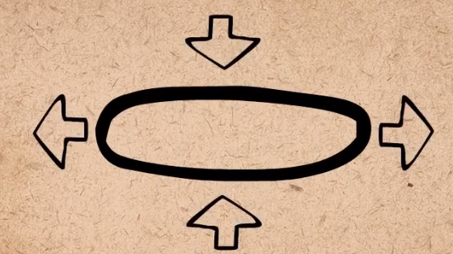
Visual arts in Character Animation
Squash and stretch
As the object gets longer it also gets narrower
When It gets flatter it also get wider
flatter and wider
longer and narrower
Adapted from AlanBecker Tutorials- The 12 principles of animation by Frank Thomas & Ollie Johnston
Adapted from Andy Beane: 3D animation essentials 2012 by John Wiley & Sons, Inc.,

Slide 46
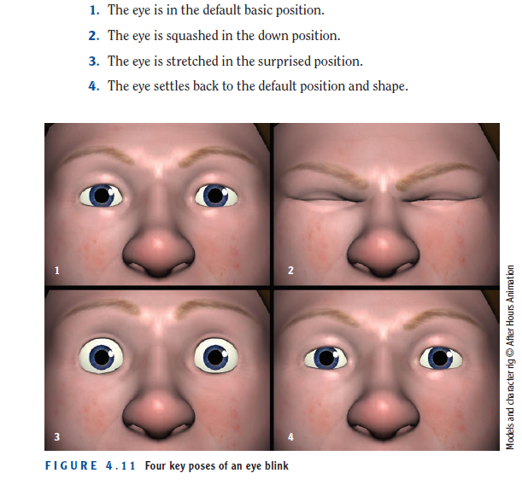
Visual arts in Character Animation
Squash and stretch
Adapted from Andy Beane: 3D animation essentials 2012 by John Wiley & Sons, Inc.,

Slide 47
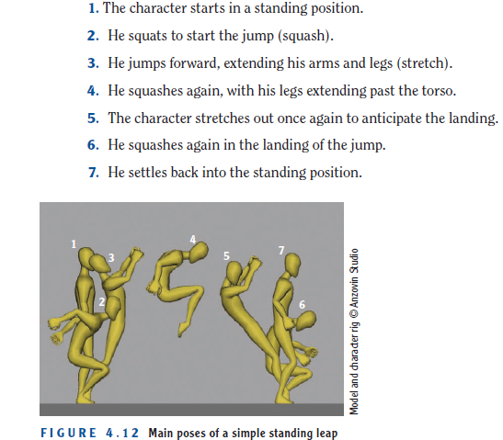
Visual arts in Character Animation
Squash and stretch
Adapted from Andy Beane: 3D animation essentials 2012 by John Wiley & Sons, Inc.,

Slide 48
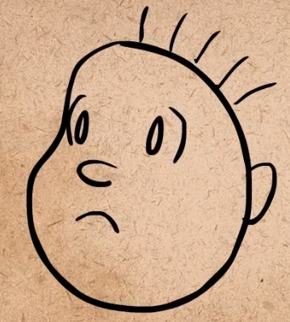
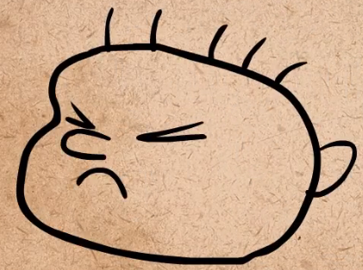
Visual arts in Character Animation
Anticipation
Anticipation is a principle indicating that the audience should see or understand what is going to happen before it happens.
With anticipation
Without anticipation
Adapted from AlanBecker Tutorials- The 12 principles of animation by Frank Thomas & Ollie Johnston
Adapted from Andy Beane: 3D animation essentials 2012 by John Wiley & Sons, Inc.,

Slide 49
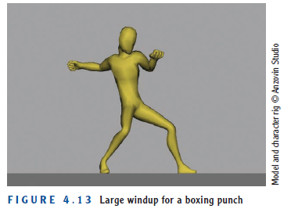
Visual arts in Character Animation
Anticipation
There are multiple levels (different actions before end) of anticipation
Adapted from Andy Beane: 3D animation essentials 2012 by John Wiley & Sons, Inc.,

Slide 50
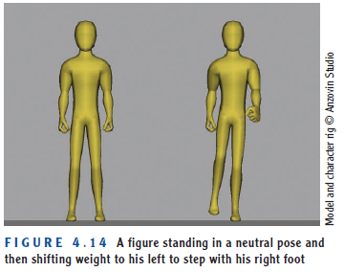
Visual arts in Character Animation
Anticipation examples
Adapted from Andy Beane: 3D animation essentials 2012 by John Wiley & Sons, Inc.,

Slide 51
Visual arts in Character Animation
Staging
Staging is the way you will fill your screen with the motion of animation and the placement of objects to allow the audience to best understand what is happening.
When using the camera, it is important to know when to be:
C lose up
Or Faraway
Faraway is good for big actions
C lose up is good for expressions
Adapted from Andy Beane: 3D animation essentials 2012 by John Wiley & Sons, Inc.,

Slide 52
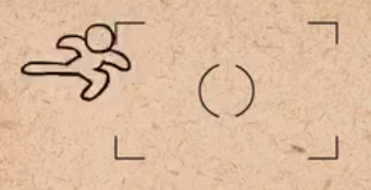
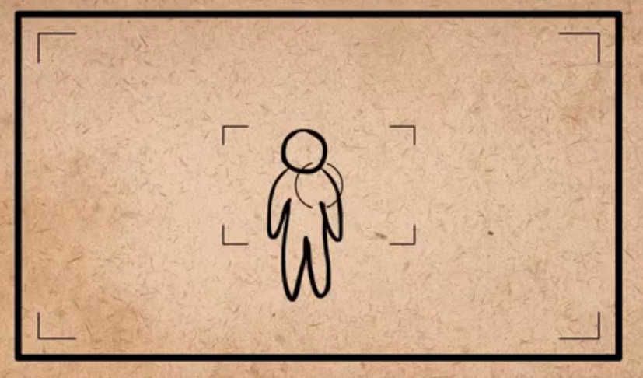
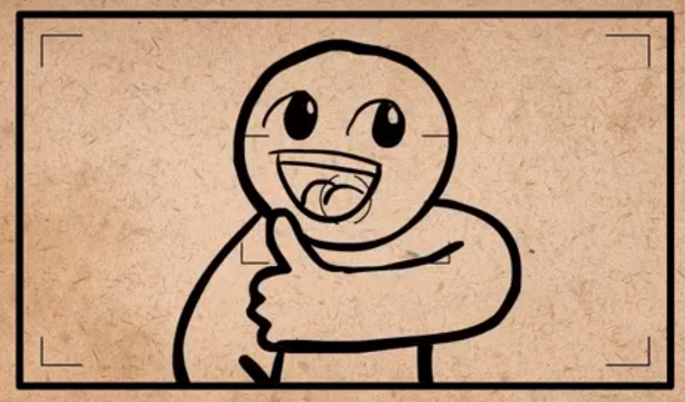
Visual arts in Character Animation
Staging
Faraway
C lose up
Adapted from AlanBecker Tutorials- The 12 principles of animation by Frank Thomas & Ollie Johnston
Adapted from Andy Beane: 3D animation essentials 2012 by John Wiley & Sons, Inc.,

Slide 53
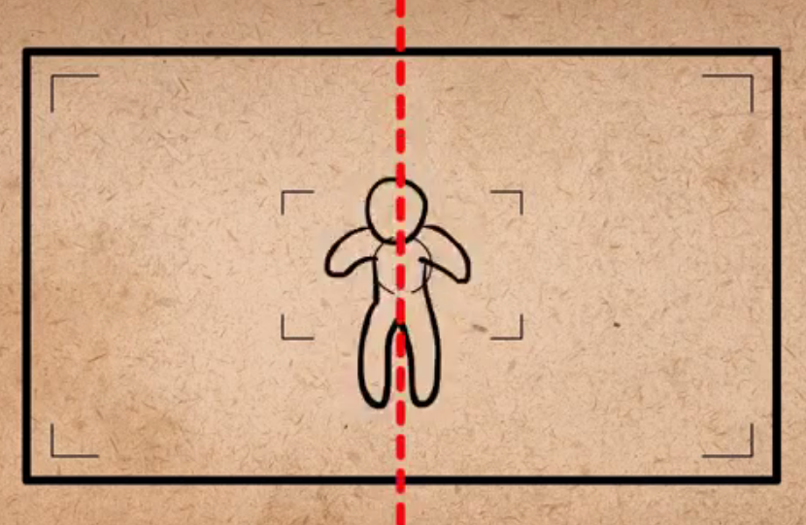
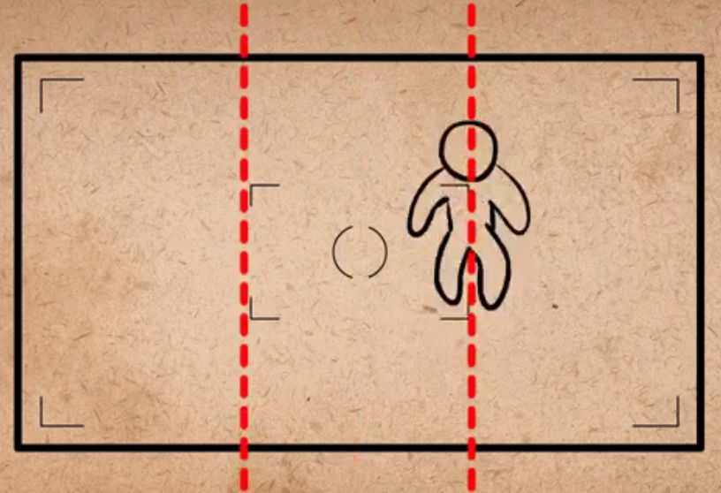
Visual arts in Character Animation
Staging
Do not have the main action be off the side
It should be either in the center of the screen or in one of the thirds of the screen
The center of the screen
The thirds of the screen
Adapted from AlanBecker Tutorials- The 12 principles of animation by Frank Thomas & Ollie Johnston
Adapted from Andy Beane: 3D animation essentials 2012 by John Wiley & Sons, Inc.,

Slide 54
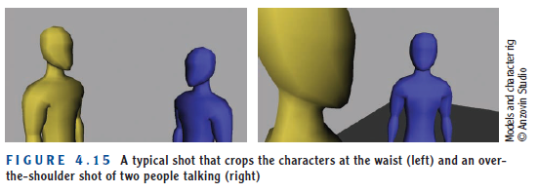
Visual arts in Character Animation
Staging examples
Adapted from Andy Beane: 3D animation essentials 2012 by John Wiley & Sons, Inc.,

Slide 55
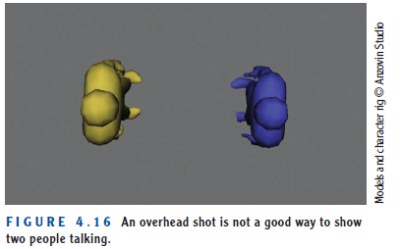
Visual arts in Character Animation
Staging
Adapted from Andy Beane: 3D animation essentials 2012 by John Wiley & Sons, Inc.,

Slide 56
The End

